Slide 1
Key challenges
Zhaoliang Zheng

Slide 2
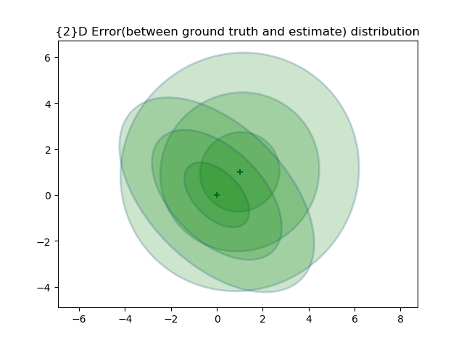
To determine the 3-sigma boundary
6.3
How?
-4.2
- 4.2
6.3

